Slide 1


Slide 2
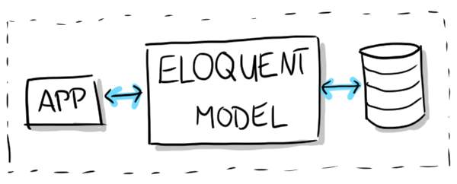
Model Lec 6
php artisan make:model // To Create model
Defining Models
Retrieving Models
Inserting & Updating & Deleting Models

Slide 3
php artisan make:model -h Model
Description:
Create a new Eloquent model class
Usage:
make:model [options] [--] <name>
Arguments:
name The name of the class
Options:
-a, --all Generate a migration, factory, and resource controller for the model
-c, --controller Create a new controller for the model
--force Create the class even if the model already exists
-m, --migration Create a new migration file for the model
-r, --resource Indicates if the generated controller should be a resource controller
EX suggestion
php artisan make:model -mcr test
php artisan make:model --migration --controller --resource test

Slide 4
Defining Models
Eloquent Model Conventions
protected $table = 'Emp';
protected $fillable = [ 'EName', 'BDate'];
protected $primaryKey = ‘DName';
protected $keyType= ‘string';
public $incrementing = false;
protected $perPage= 15;
public $timestamps = false;
const CREATED_AT = 'creation_date';
const UPDATED_AT = 'last_update';
Default Attribute Values
protected $attributes = [ 'delayed' => false ];

Slide 5
Eloquent: Relationships
One To One
 | Emp Model | Dept Model
Defining | class Emp extends Model { public function Dept() { return $this->hasOne('App\Dept'); } } | class Dept extends Model { public function Manager() { return $this->belongsTo('App\Emp'); } }
Call | $dept = Emp::find(1)->Dept; | $emp = Dept::find(1)->Manager;

Slide 6
Eloquent: Relationships
One To Many
 | Post Model | Comment Model
Defining | class Post extends Model { public function comments() { return $this->hasMany('App\Comment'); } } | class Comment() extends Model { public function post() { return $this->belongsTo('App\Post'); } }
Call | $comments = App\Post::find(1)->comments; foreach ($comments as $comment) { // } | $comment = App\Comment::find(1); echo $comment->post->title;

Slide 7
Eloquent: Relationships
Many To Many
 | User Model | Role Model
Defining | class Post extends Model { public function roles(){ return $this->belongsToMany('App\Role'); } } | class Comment() extends Model { public function post() { return $this->belongsToMany('App\User'); } }
Call | $user = App\User::find(1); foreach ($user->roles as $role) { // } | $comment = App\Comment::find(1); echo $comment->post->title;

Slide 8
Retrieving Models
Retrieve a model by its primary key
$Emp= App\Emp::find(1);
$Emps = App\Emp::find([1, 2, 3]);
Retrieve the first model matching
$Emp= App\Emp::where('active', 1)->first();
Retrieving Aggregates
$count = App\Emp::where('active', 1)->count();
$max = App\Emp::where('active', 1)->max('price');
$sum= App\Emp::where('active', 1)->sum ('price');
$min= App\Emp::where('active', 1)->min('price');

Slide 9
Inserting & Updating Models
Inserts {{ route('Emp.store') }}
$Emp= new Emp;
$Emp->name = $request->name;
$Emp->save();
Updates {{ route('Emp.update',[$emp->EmpID]) }}
$Emp= App\Emp::find(1);
$Emp->name = 'New EmpName';
$Emp->save();
Deleting {{ route('Emp.destroy ',[$emp->EmpID]) }}
$Emp= App\Emp::find(1);
$Emp->delete();
App\Emp::destroy(1, 2, 3);

Slide 10
EX
$request->validate([
' name' => 'required',
'Email' => 'required',
'MylogoPhoto' => 'required|image|mimes:jpeg,png,jpg,gif,svg'
]);
$Emp= new Emp;
$ Emp >fill( $request->only($ Emp >getFillable()));
$Emp->save();

